Slide 1
Information and Coding Theory
4.
Source: https://uotechnology.edu.iq/ce/lectures%202014/dr%20ryadh%20inth2/Information%20Theory2.pdf

Slide 2
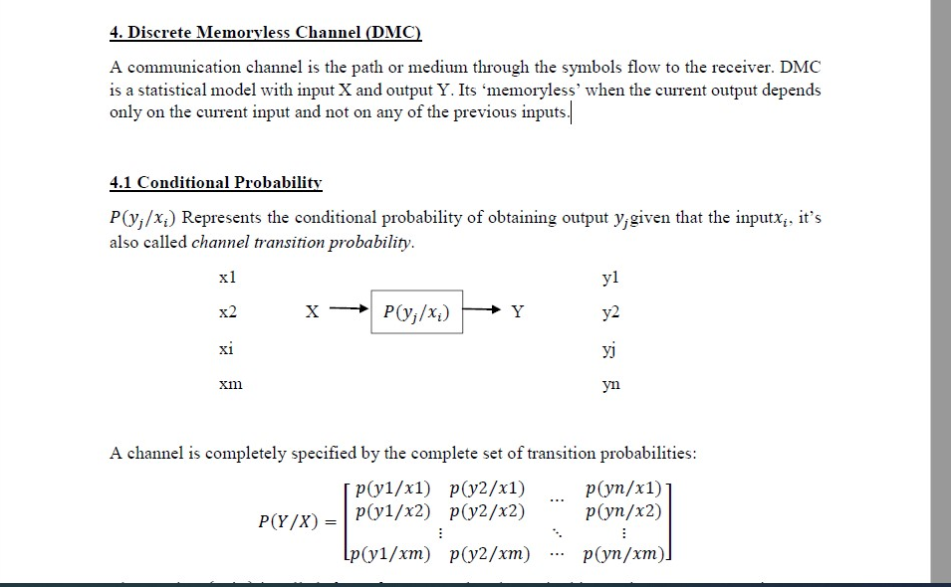

Slide 3
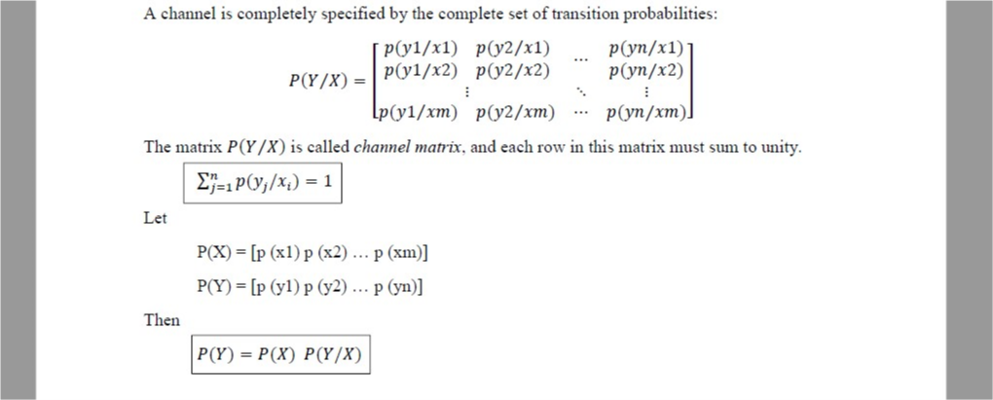

Slide 4
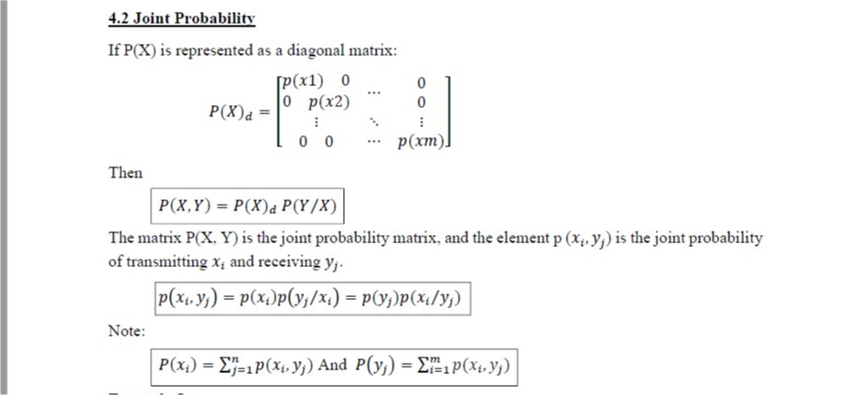
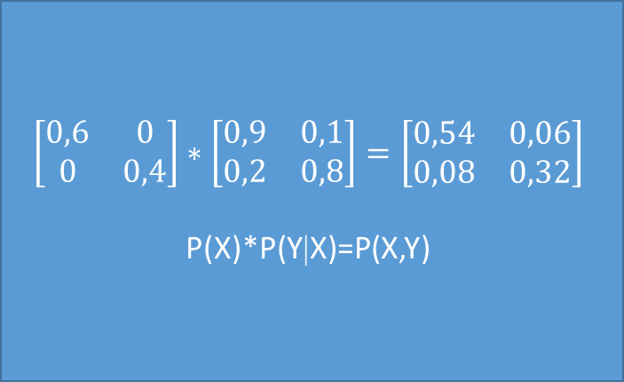
$$\left[\begin{matrix}0,6 & 0 \\ 0 & 0,4\end{matrix}\right]∗\left[\begin{matrix}0,9 & 0,1 \\ 0,2 & 0,8\end{matrix}\right]=\left[\begin{matrix}0,54 & 0,06 \\ 0,08 & 0,32\end{matrix}\right]$$
P(X)*P(Y|X)=P(X,Y)

Slide 5
Binary Channels

Slide 6
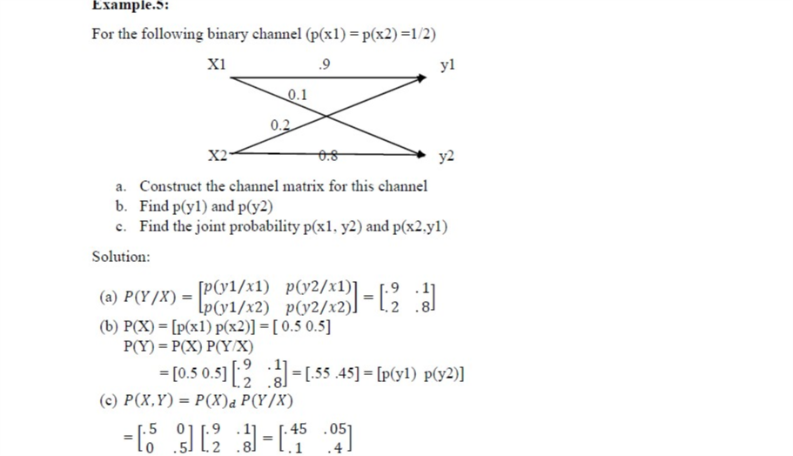

Slide 7
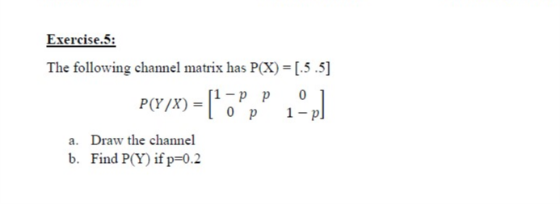

Slide 8
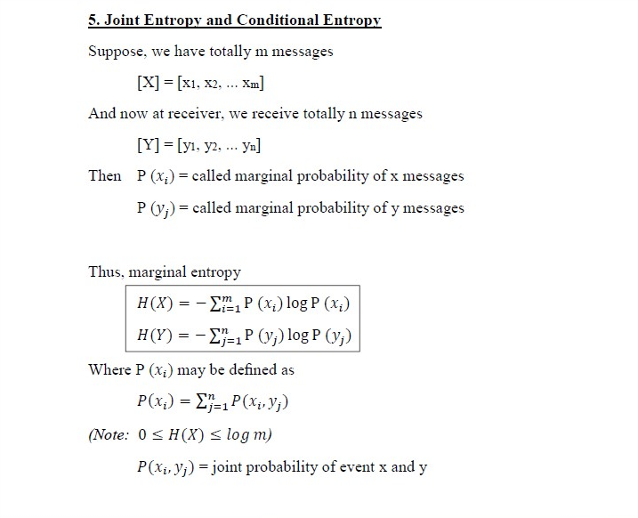

Slide 9
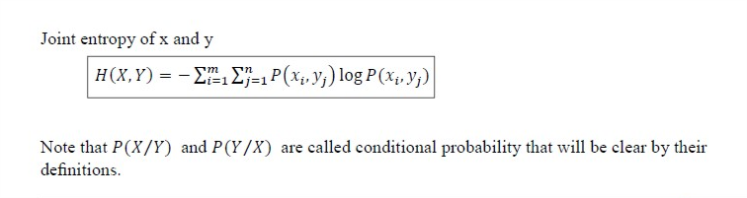
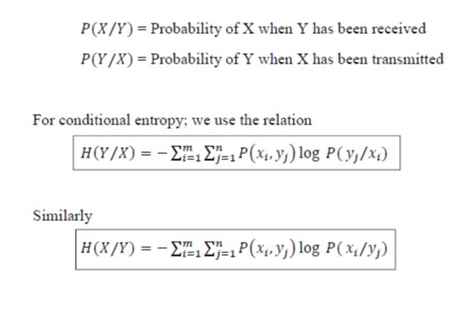
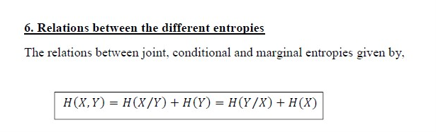

Slide 10
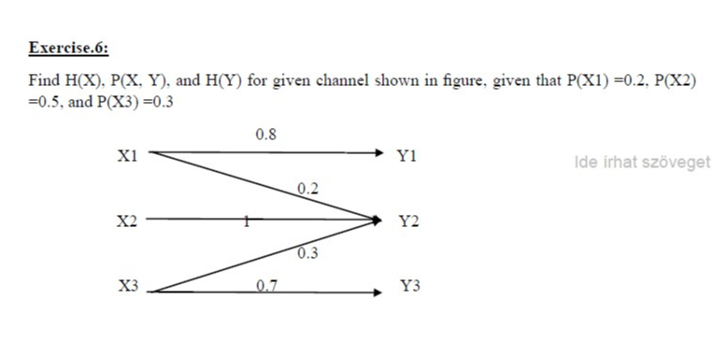

Slide 11
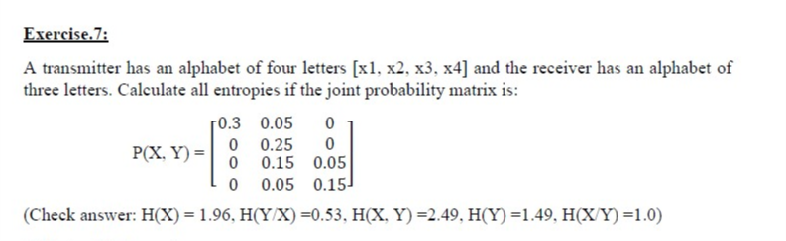

Slide 12
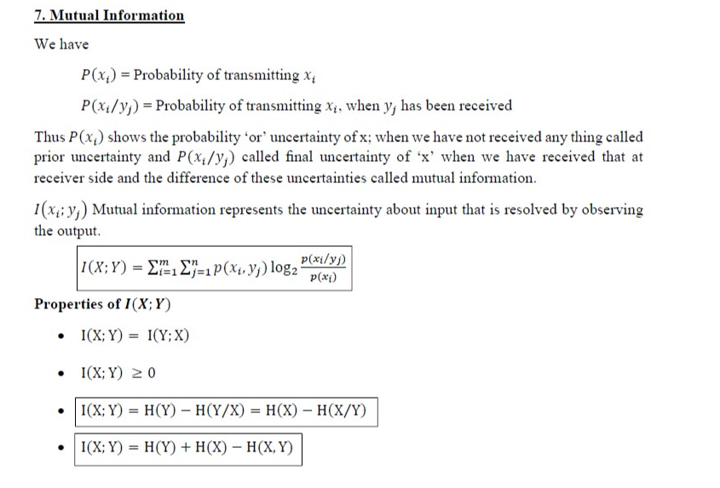
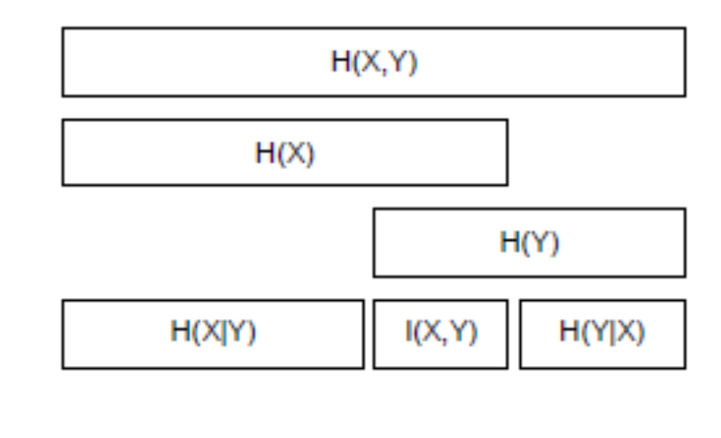

Slide 13
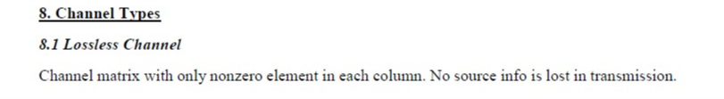
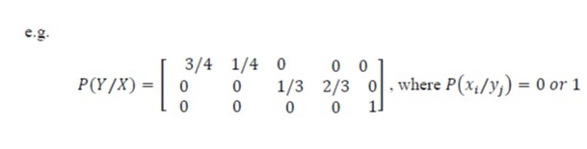

Slide 14
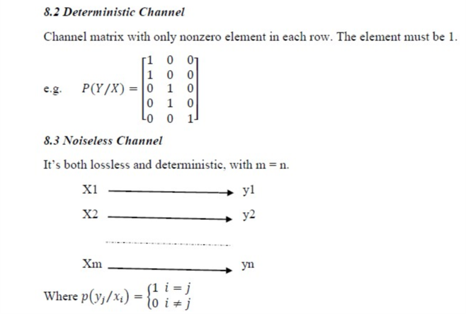

Slide 15
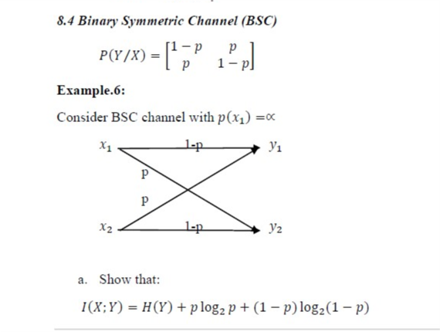
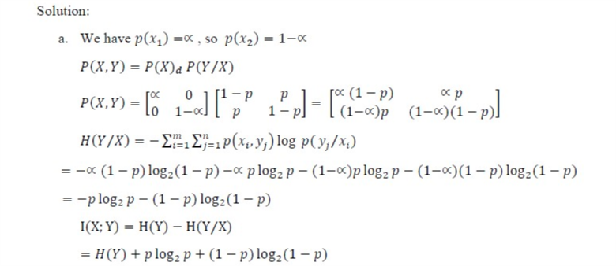
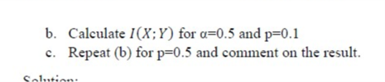

Slide 16
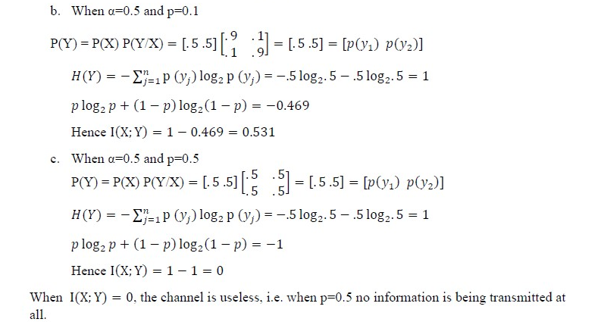

Slide 17
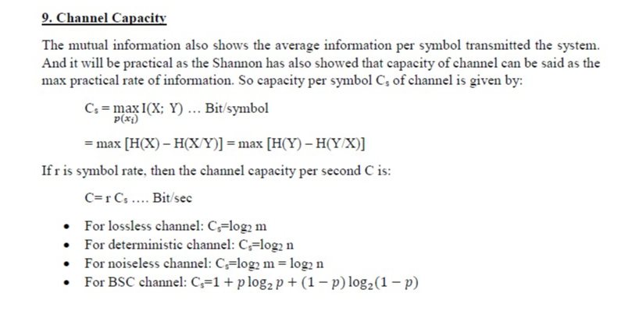

Slide 18
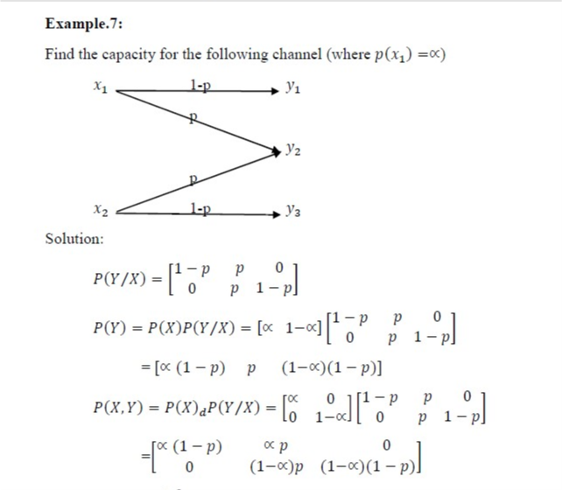
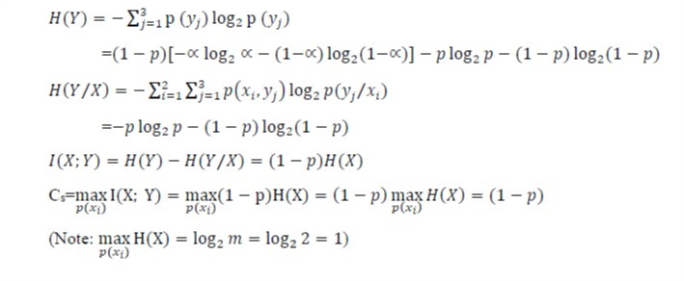

Slide 19
Homework
Enter the transmission probabilities of a binary channel and calculate the values ​​of the related parameters.
(Construct your own example!) Describe each calculation in detail!

Slide 20
References:
https://uotechnology.edu.iq/ce/lectures%202014/dr%20ryadh%20inth2/Information%20Theory2.pdf

